Slide 1

INSPIRING STUDENTS TO
STUDY IN NEPAL

Slide 2
IEPAN
IEPAN stands for “International Education Providers’ Association of Nepal”
IEPAN was registered with District Administration Office, Kathmandu, as an Association.
It was registered on March 2014
Now we are 32 members in the association

Slide 3
Vision and Mission
Vision
Promoting WORLD CLASS UNIVERSITIES in Nepal and develop Nepal as study destination in Asia.
Mission
To promote “Study in Nepal” for Asia and bring international students to Nepal for study.
To increase remittance in Nepal through education tourism.

Slide 4
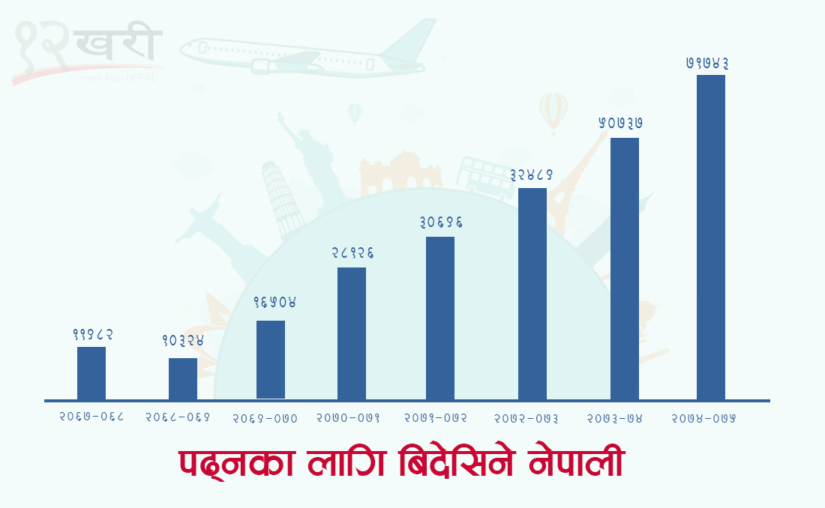
Number of students studying abroad.

Slide 5
Total no of affiliated colleges in Nepal: 95
Total number of students presently studying in foreign affiliated colleges in Nepal: approx. 50,000/-
International Colleges and Student Number

Slide 6
Current issues
  Delays in dollar exchange approval from Ministry of Education and Nepal Rastra Bank.
  Delays in the license renewal of the current colleges.
  Delays in approval the change of course and place.
  Negative rumors, suggestions and mindset of local authorities about colleges offering international course.

Slide 7
IEPAN CONTRIBUTION TO NEPAL
Most students who went to India, Malaysia and some Asian countries for studying International Bachelor and Master in IT, Business and hospitality have significantly decreased saving countries revenue.
Recognizing Nepal as destination for world class universities and education.
CONTRIBUTING in Education Tourism.

Slide 8
ATTRACTION OF NEPAL FOR ASIAN STUDENTS
Nepal offers world class university courses for Asian students.
Fees are affordable in compared to other Asian countries offering international degrees.
GOOD WEATHER
Good life style and open society in South Asia.
Beautiful country with hill and mountains to explore during studies.
Safer place to study and learn.

Slide 9
IEPAN PLANS to promote
“Study in Nepal” and numbers
Year | International student number per year | Fee per student | Approx Inward Remittance per year | In Nrs.
2023 | 1,000/- | $4000/year | $40,00,000/yr | Nrs. 50 crore
2024 | 3,000/- | $4000/year | $1,20,00,000/yr | Nrs. 1 Arab, 20 crore.
2025 | 5,000/- | $ 4000/year | $2,00,00,000/yr | Nrs. 2 Arab
2026 | 10,000/- | $ 5000/year | $5,00,00,000/yr | Nrs. 5 Arab.
Besides students, parents and relatives of students visit Nepal to promote Tourism and bring significant revenue to Nepal.

Slide 10
Asian Countries Offering
International Degrees
COUNTRIES
MALAYSIA
SINGAPORE
THAILAND
HONGKONG
BANGLADESH
PHILIPPINES
VIETNAM
INDONESIA
DUBAI
SRILANKA
CHINA
India has recently announced to invite world class universities to delivery courses in India.

Slide 11
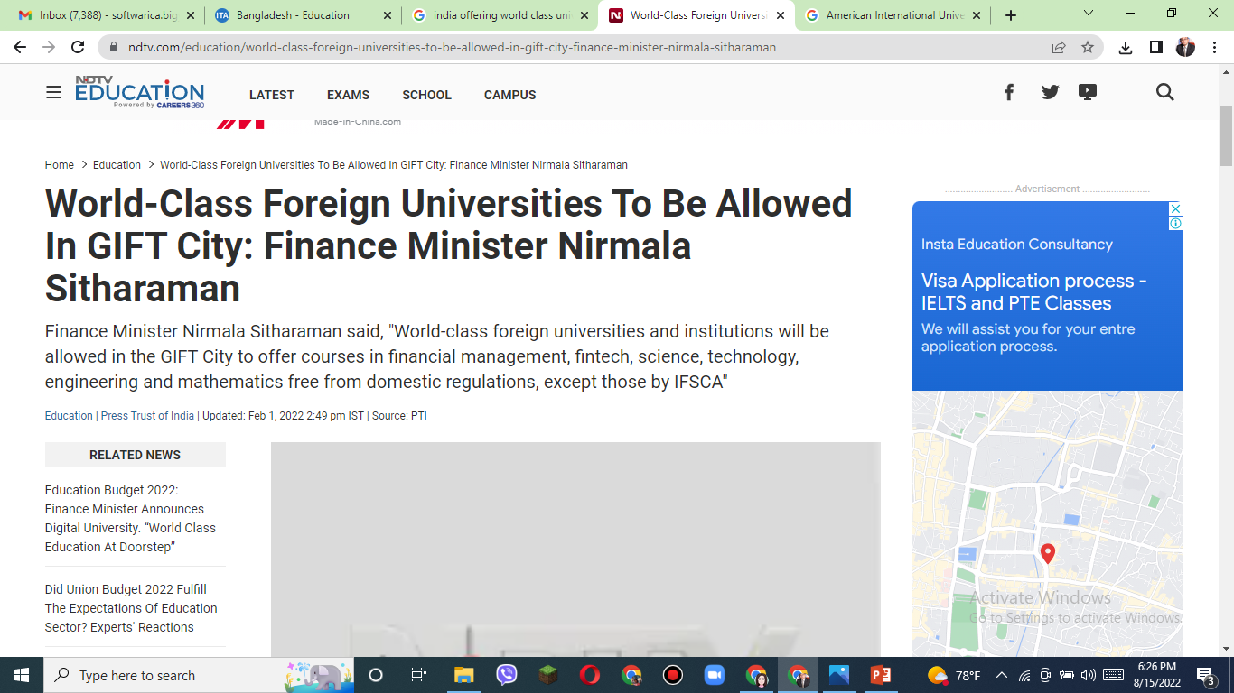

Slide 12


Slide 13
Lets together dream
New Nepal BY 2025
DESTINATION OF WORLD CLASS UNIVERSITIES
BRING 10,000 STUDENTS FROM ASIA
STRONG BUILT OF EDUCATION TOURISM

Slide 14
FEW Suggestions and recommendations from IEPAN
To Ministry of Education
Approve or disapprove any new course applied within a time frame (may be 1 year).
Renew all the institutions as soon as possible.
Facilitate to the colleges in providing approval of foreign dollar exchange to remit students registration and exam fees on time.
To add “QS Ranking” besides the “Time Higher Education” and “Sanghai Ranking” to verify the university ranking to deliver courses in Nepal.

Slide 15
FEW Suggestions and recommendations from IEPAN
To Ministry of Education
To strictly follow the International college directives by all parties.
Facilitate in the visa application and processing of international students who are willing to study in Nepal.
Help IEPAN promote “Study in Nepal” campaign by formation of a committee inside the Ministry of Education.
Allow IEPAN to use Ministry of Education logo to promote “Study in Nepal”.

Slide 16


